Slide 1
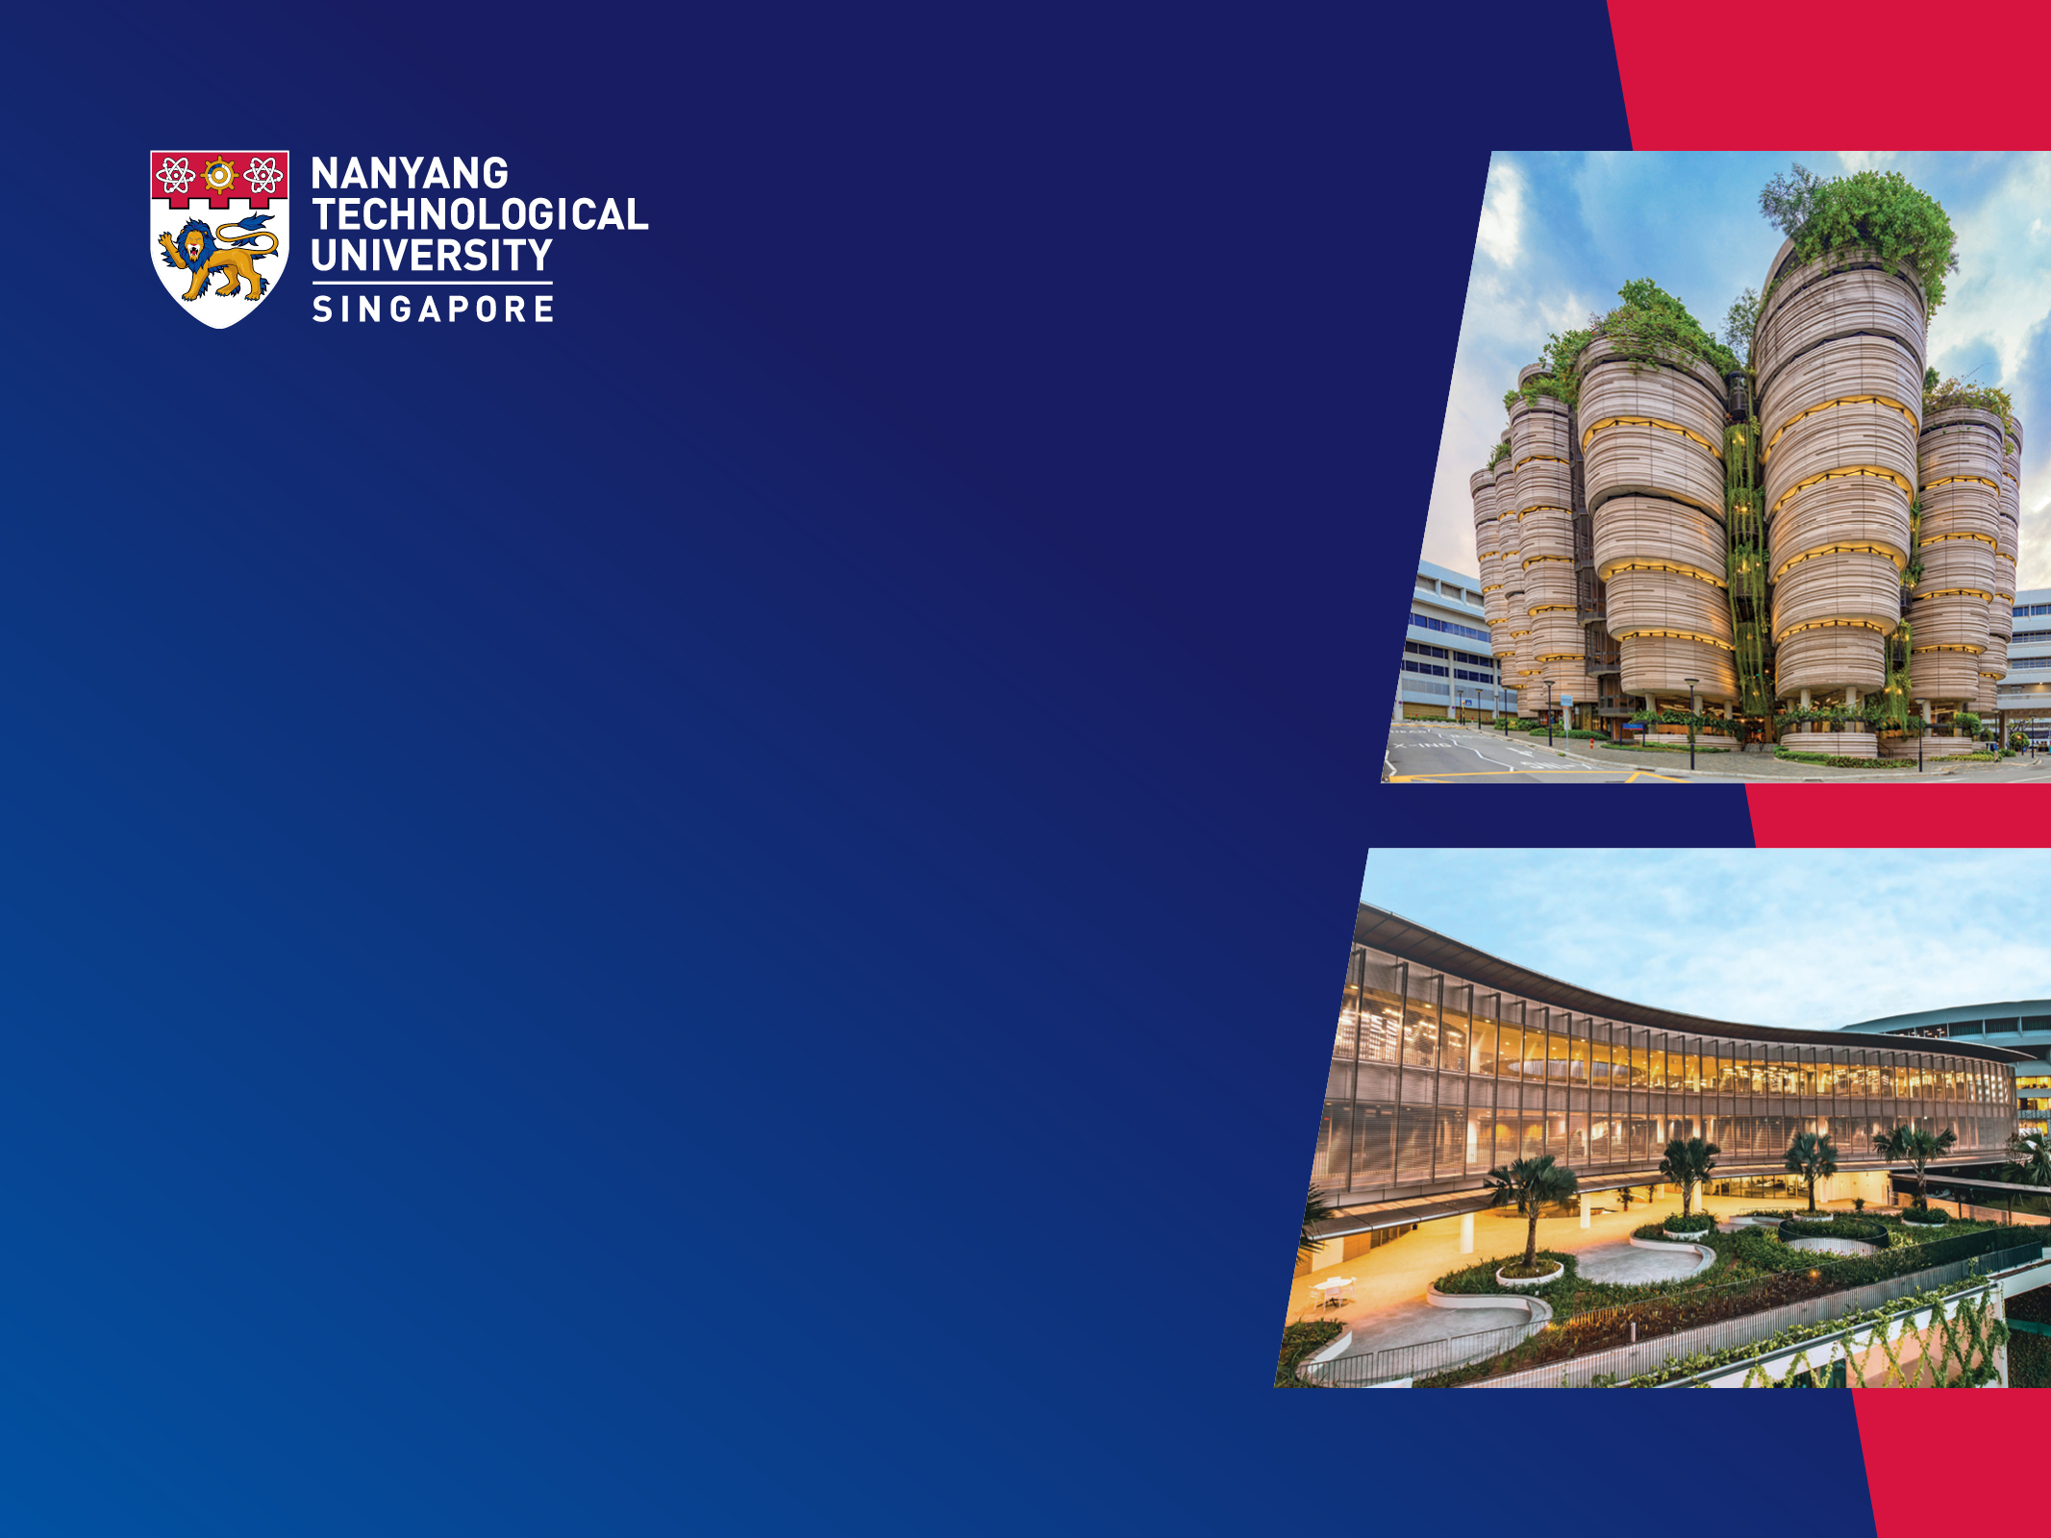
Punctuation Restoration for Speech Transcripts Using Large Language Models SCSE23-0753
Presenter: Liu Changsong
Supervisor: Assoc. Prof. Chng Eng Siong
School of Computer Science and Engineering
03 May 2024

Slide 2
Introduction
Methodology
Experiment
Conclusion
Outline
Introduction
Background
Motivation
Literature Review
Methodology
Experiment
Conclusions & Future Work

Slide 3
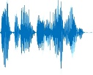
1.1 Background
Introduction
Methodology
Experiment
Conclusion
Punctuation
Capitalization
Problem Statement
Inverse Text Normalization
Speech transcripts often lack punctuation.
Causes ambiguity for humans and affects downstream tasks for machine.
Automatic
Speech Recognition (ASR) System
scse is at block four along nanyang avenue
SCSE is at block 4 along Nanyang Avenue.
Punctuation Restoration

Slide 4
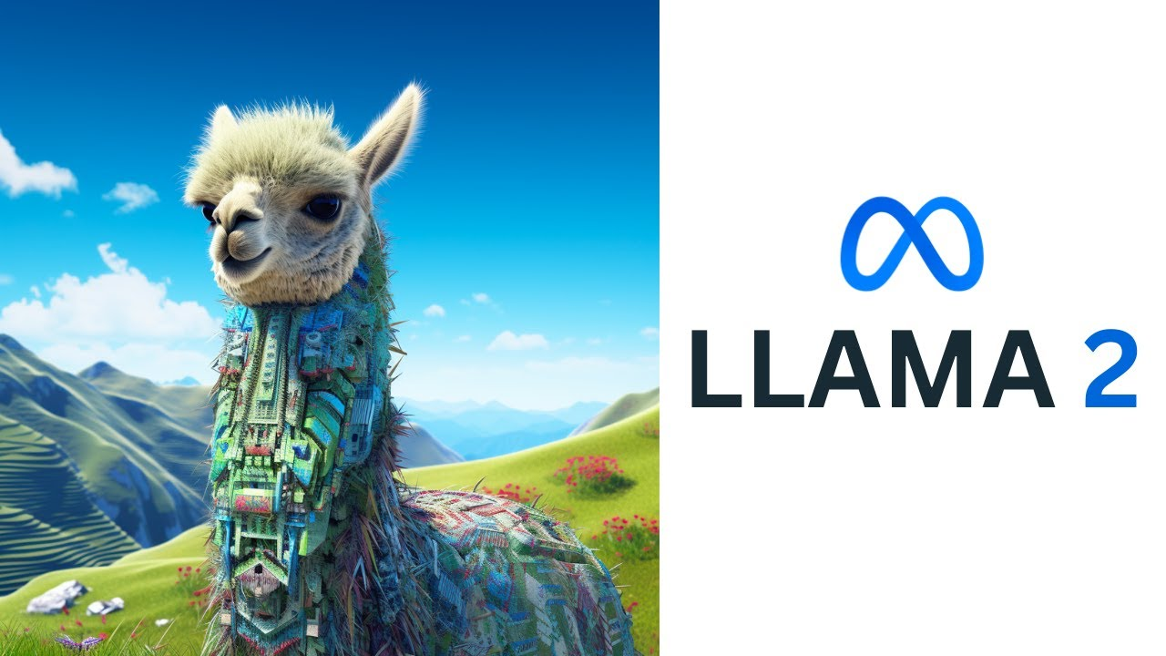
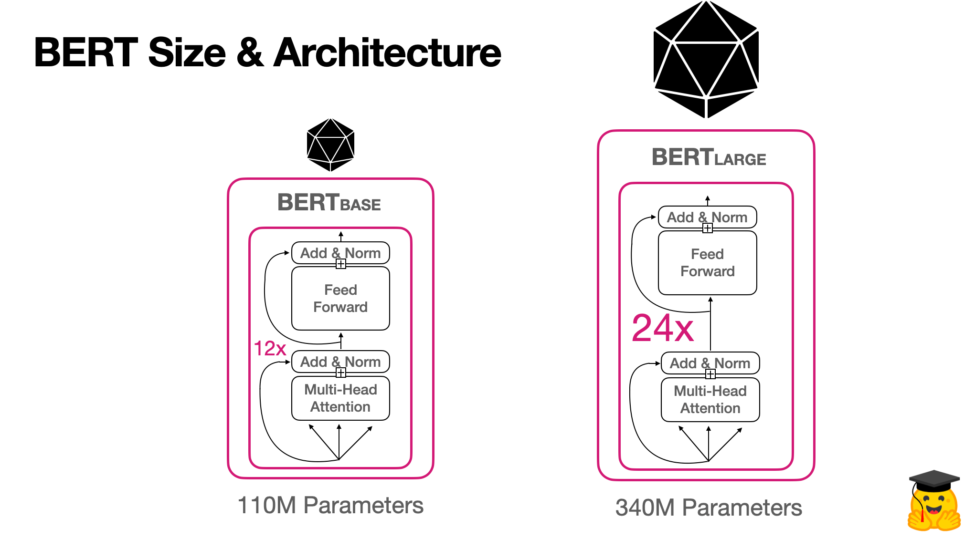

1.1 Background
Introduction
Methodology
Experiment
Conclusion
Problem Statement
Speech transcripts often lack punctuation.
Causes ambiguity for humans and affects downstream tasks for machine.
Automatic
Speech Recognition (ASR) System
Punctuation Restoration
Output Sentences
input sentences

Slide 5
1.2 Motivation
Introduction
Methodology
Experiment
Conclusion
Why use LLM for punctuation restoration?
LLMs are powerful in NLP tasks.
LLMs have been used for punctuation restoration.
To leverage LLM’s power in punctuation restoration.
To evaluate if small LLMs can be optimized to match the performance of SOTA LLMs.

Slide 6
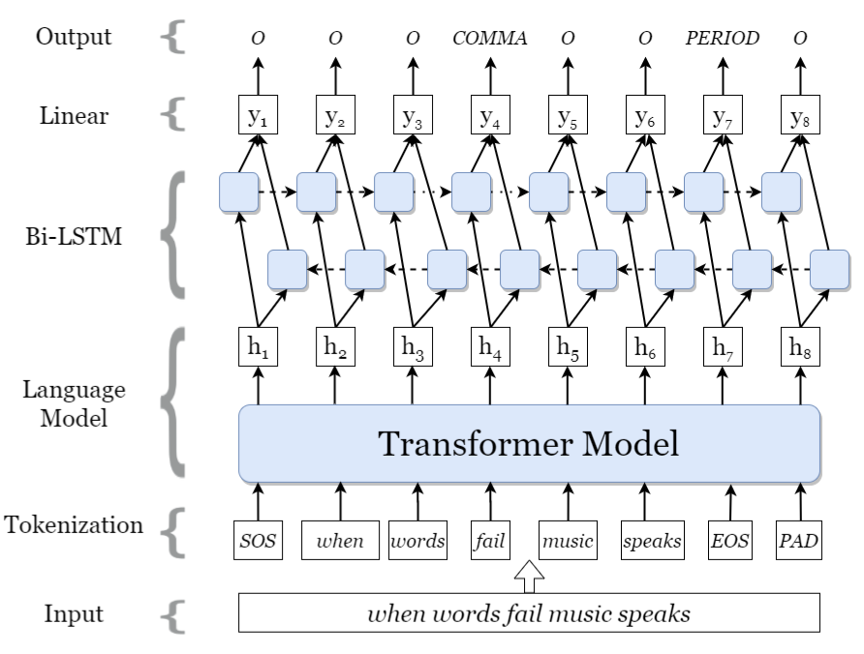
1.3 Literature Review
Introduction
Methodology
Experiment
Conclusion
How pre-LLMs are used for punctuation restoration?
[1] explores models including BERT, RoBERTa, and ALBERT etc.
[1] proposes an augmentation strategy to simulate substitution, insertion, and deletion of ASR transcript.
Output
Punctuation Restoration
Output Sentences
input sentences
Punctuation Restoration
Output Sentences
input sentences
Pre-LLM
Input
[1] Tanvirul Alam, Akib Khan, and Firoj Alam. Punctuation restoration using transformer models for high-and low-resource languages. In Proceedings of the Sixth Workshop on Noisy User-generated Text (W-NUT 2020), pages 132–142, 2020.

Slide 7
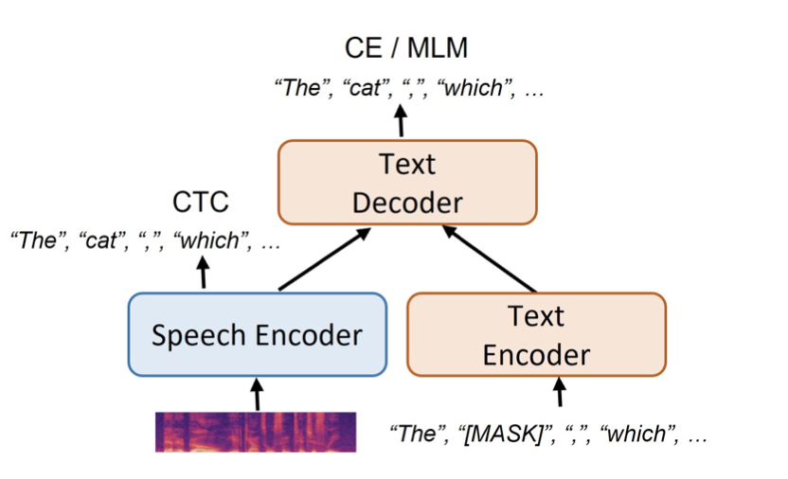
1.3 Literature Review
Introduction
Methodology
Experiment
Conclusion
How LLMs are used for punctuation restoration?
Automatic
Speech Recognition (ASR) System
[1] integrates pretrained LLMs with speech recognition models for punctuation restoration.
Used LoRA to tune LLMs for decoder-only models.
Punctuation Restoration
Punctuation Restoration
Output Sentences
input sentences
Output Sentences
input sentences
Main focus for this project
[1] Shaoshi Ling, Yuxuan Hu, Shuangbei Qian, Guoli Ye, Yao Qian, Yifan Gong, Ed Lin, and Michael Zeng. Adapting large language model with speech for fully formatted end-to-end speech recognition. arXiv preprint arXiv:2307.08234, 2023.

Slide 8
1.3 Literature Review
Introduction
Methodology
Experiment
Conclusion
How LLMs are used for punctuation restoration?
[1] utilizes a GPT-2, for data generation for punctuation restoration.
[1] introduces an RL approach where the PR model evaluates the punctuation accuracy of the generated text and provides feedback to GPT-2 for better generation.
[1] Viet Dac Lai, Abel Salinas, Hao Tan, Trung Bui, Quan Tran, Seunghyun Yoon, Hanieh Deilamsalehy, Franck Dernoncourt, and Thien Huu Nguyen. Boosting punctuation restoration with data generation and reinforcement learning. arXiv preprint arXiv:2307.12949, 2023.

Slide 9
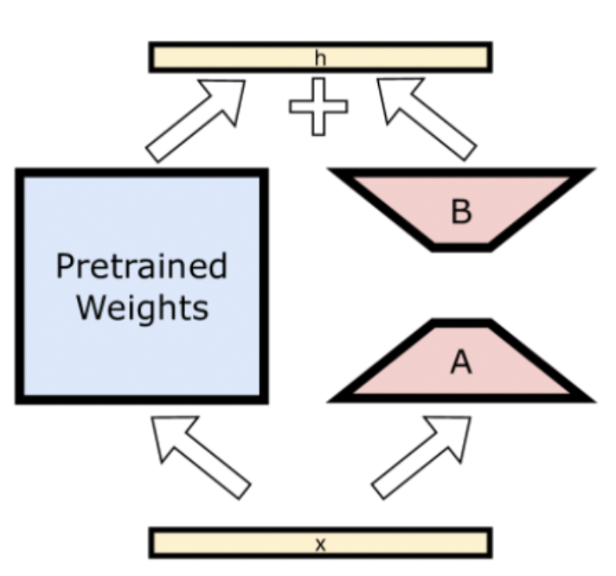
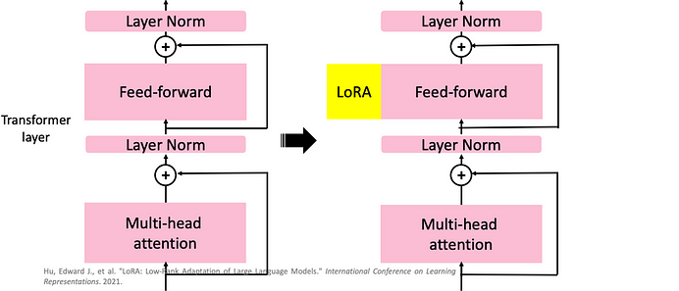
1.3 Literature Review
Introduction
Methodology
Experiment
Conclusion
What are the fine-tuning techniques for LLMs?
LoRA ^{[1]}
Adapters ^{[2]}
Prompt Engineering
Full Model Tuning
LoRA
Illustration of LoRA^{[1]} technique
[1] Edward J Hu, Yelong Shen, Phillip Wallis, Zeyuan Allen-Zhu, Yuanzhi Li, Shean Wang, Lu Wang, and Weizhu Chen. Lora: Low-rank adaptation of large language models. arXiv preprint arXiv:2106.09685, 2021.

Slide 10
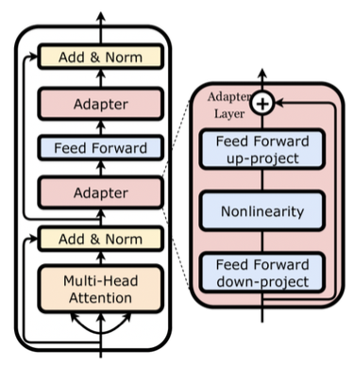
1.3 Literature Review
Introduction
Methodology
Experiment
Conclusion
What are the fine-tuning techniques for LLMs?
LoRA ^{[1]}
Adapters ^{[2]}
Prompt Engineering
Full Model Tuning
Illustration of and Adapters^{[2]}
[1] Zhiqiang Hu, Yihuai Lan, Lei Wang, Wanyu Xu, Ee-Peng Lim, Roy Ka-Wei Lee, Lidong Bing, and Soujanya Poria. Llm-adapters: An adapter family for parameter-efficient fine-tuning of large language models. arXiv preprint arXiv:2304.01933, 2023.

Slide 11
1.3 Literature Review
Introduction
Methodology
Experiment
Conclusion
What are the fine-tuning techniques for LLMs?
Prompt Engineering
LoRA ^{[1]}
Adapters ^{[2]}
Prompt Engineering
Full Model Tuning
Pre-trained Model
* Frozen *
Engineered Prompt
Input Text
Illustration of Prompt Engineering
[1] Edward J Hu, Yelong Shen, Phillip Wallis, Zeyuan Allen-Zhu, Yuanzhi Li, Shean Wang, Lu Wang, and Weizhu Chen. Lora: Low-rank adaptation of large language models. arXiv preprint arXiv:2106.09685, 2021.
[2] Zhiqiang Hu, Yihuai Lan, Lei Wang, Wanyu Xu, Ee-Peng Lim, Roy Ka-Wei Lee, Lidong Bing, and Soujanya Poria. Llm-adapters: An adapter family for parameter-efficient fine-tuning of large language models. arXiv preprint arXiv:2304.01933, 2023.

Slide 12
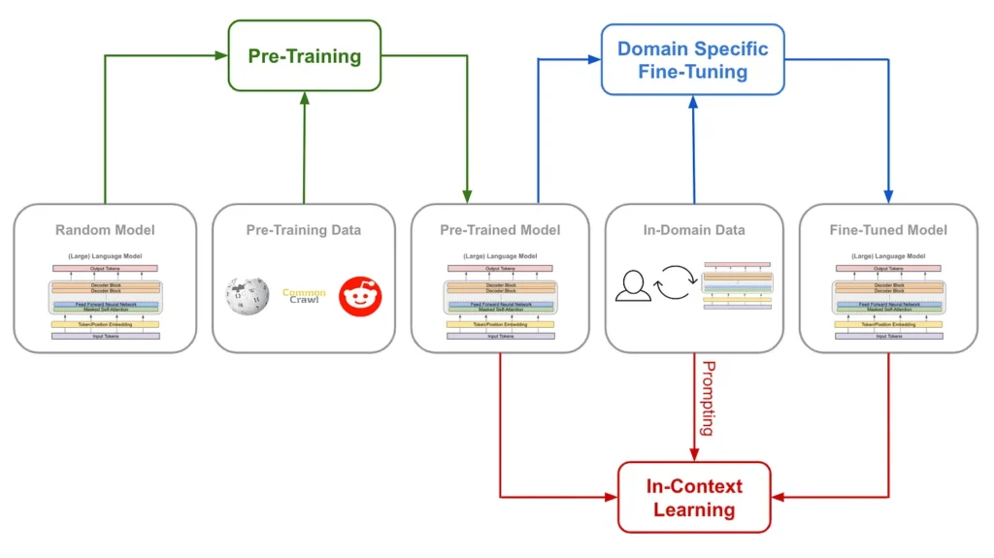
1.3 Literature Review
Introduction
Methodology
Experiment
Conclusion
What are the fine-tuning techniques for LLMs?
LoRA ^{[1]}
Adapters ^{[2]}
Prompt Engineering
Full Model Tuning
Illustration of Full Model Finetuning^{[3]}
[1] Edward J Hu, Yelong Shen, Phillip Wallis, Zeyuan Allen-Zhu, Yuanzhi Li, Shean Wang, Lu Wang, and Weizhu Chen. Lora: Low-rank adaptation of large language models. arXiv preprint arXiv:2106.09685, 2021.
[2] Zhiqiang Hu, Yihuai Lan, Lei Wang, Wanyu Xu, Ee-Peng Lim, Roy Ka-Wei Lee, Lidong Bing, and Soujanya Poria. Llm-adapters: An adapter family for parameter-efficient fine-tuning of large language models. arXiv preprint arXiv:2304.01933, 2023.
[3] 4 Pillars to Effective Training of Large Language Models https://hyperight.com/4-pillars-to-effective-training-of-large-language-models/

Slide 13
Introduction
Methodology
Experiment
Conclusion
Outline
Introduction
Methodology
XLM-RoBERTa
Model Architecture
Model Refinement
Model Checkpoint Ensemble
Llama-2
Prompt Engineering
Fine-tuning with LoRA
Experiment
Conclusions & Future Work

Slide 14
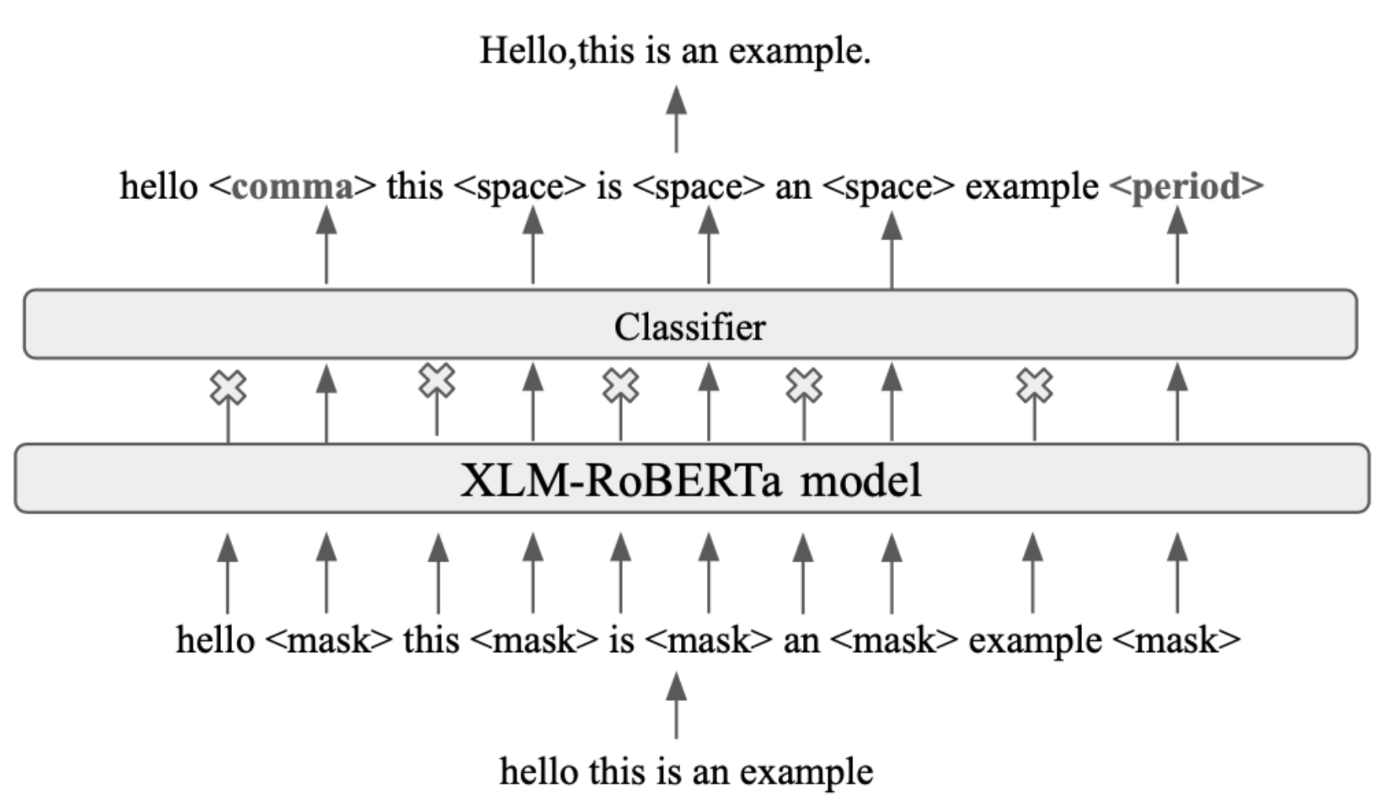
2.1 XLM-RoBERTa
Introduction
Methodology
Experiment
Conclusion
Model Architecture
Employs model architecture^{[1]} comprising pretrained XLM-R model followed by a classifier.
[1] Abhinav Rao, Ho Thi-Nga, and Chng Eng Siong. Punctuation restoration for singaporean spoken languages: English, malay, and mandarin. In 2022 Asia-Pacific Signal and Information Processing Association Annual Summit and Conference (APSIPA ASC), pages 546–552. IEEE, 2022.

Slide 15
2.1 XLM-RoBERTa
Introduction
Methodology
Experiment
Conclusion
Model Refinement
Customized number of punctuation classes.
Modified token value for space: 6 250004
Implements evaluation pipeline for external datasets.
Implements detokenize process to evaluate at word level instead of token level.

Slide 16
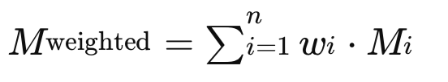
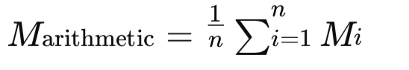
2.1 XLM-RoBERTa
Introduction
Methodology
Experiment
Conclusion
Model Checkpoint Ensemble
An innovative way to aggregate multiple checkpoints.
Selects top-k epochs for averaging.

Slide 17
2.2 Llama-2
Introduction
Methodology
Experiment
Conclusion
Prompt Engineering
Does a detailed and clear prompt enhance the LLM’s performance?
Crafts 3 versions of prompts from simple to complex.
Goal : to solve alteration problem for generative LLMs

Slide 18
2.2 Llama-2
Introduction
Methodology
Experiment
Conclusion
Fine-tune with LoRA
LoRA updates only a set of low-rank matrices.
Freezes original weights and adds low-rank matrices back.
[1] Zhiqiang Hu, Yihuai Lan, Lei Wang, Wanyu Xu, Ee-Peng Lim, Roy Ka-Wei Lee, Lidong Bing, and Soujanya Poria. Llm-adapters: An adapter family for parameter-efficient fine-tuning of large language models. arXiv preprint arXiv:2304.01933, 2023.

Slide 19
Introduction
Methodology
Experiment
Conclusion
Outline
Introduction
Methodology
Experiment
Datasets
Data Processing
Evaluation
Connections between Experiments
Experiment 1: Baseline Model Performance
Experiment 2: Prompt Engineering for Llama-2
Experiment 3: Finetuned Llama-2
Conclusions & Future Work

Slide 20
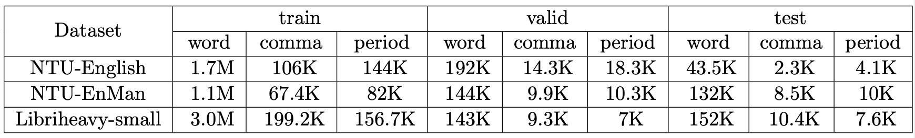
3.1 Datasets
Introduction
Methodology
Experiment
Conclusion
NTU-English: conversational English conversations focused on psychiatric evaluations. XLM-R evaluation
NTU-EnMan: codeswitching daily-life conversation. XLM-R evaluation
Libriheavy: open source, 50,000 hrs audio, texts from books + ASR transcripts. generative LLM evaluation

Slide 21
3.2 Data Processing
Introduction
Methodology
Experiment
Conclusion
Data Preprocessing
NTU-English & NTU-EnMan:
Libriheavy small:
Separate TextGrid Files
Extract
Single text corpus
Text normalization
Combine
Data Splitting
Written format
Text normalization
Remove non-vocalized sentences
Cleaned written
Spoken format
Extract & Reinsert punctuation
Data Splitting

Slide 22
3.2 Data Processing
Introduction
Methodology
Experiment
Conclusion
LLM Output Postprocessing
Generative nature of LLMs modifies names, grammar, spelling etc.
Extract & Reinsert algorithm:
Extract : Case Insensitive + Match Boundaries
Reinsert: Seek best + closest position
Special case: Skipping
LLM output
Extract punctuation
Unpunctuated spoken format (input)
Reinsert

Slide 23
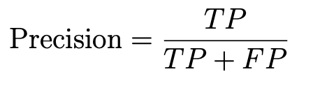
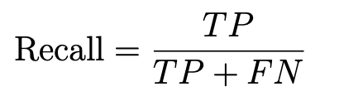
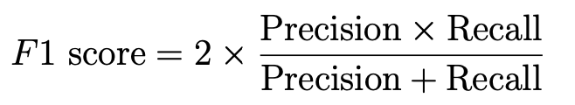
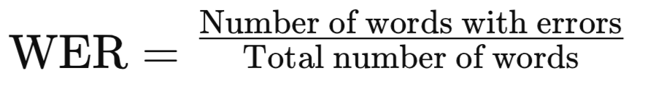

3.3 Evaluation
Introduction
Methodology
Experiment
Conclusion
Evaluation Metrics

Slide 24
3.3 Evaluation
Introduction
Methodology
Experiment
Conclusion
Unifying Evaluation Methods across Models
XLM-RoBERTa
Detokenize
Single text file
Evaluate at word level
LLM outputs
Extract & Reinsert punctuation
Single text file

Slide 25
3.4 Connections of Experiments
Introduction
Methodology
Experiment
Conclusion
What does 3 experiments do?
Experiment 1: uses XLM-RoBERTa as baseline models & tests the necessity of postprocessing steps.
Experiment 2: tests the performance and reliability of prompt engineering.
Experiment 3: Selects the best prompt from Experiment 2 as a prefix for testing fine-tuned Llama-2, base Llama-2, and SOTA Gemini by Google.

Slide 26
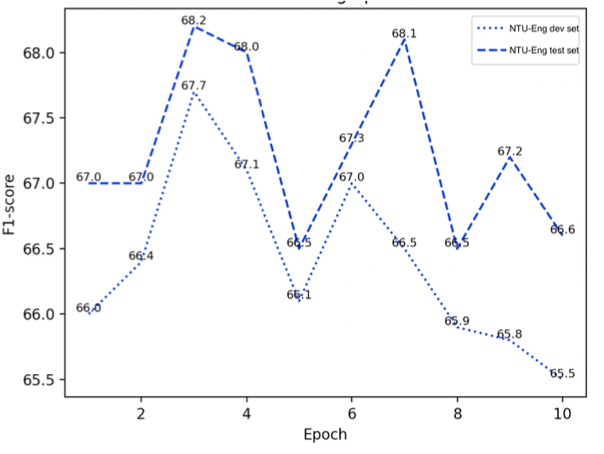
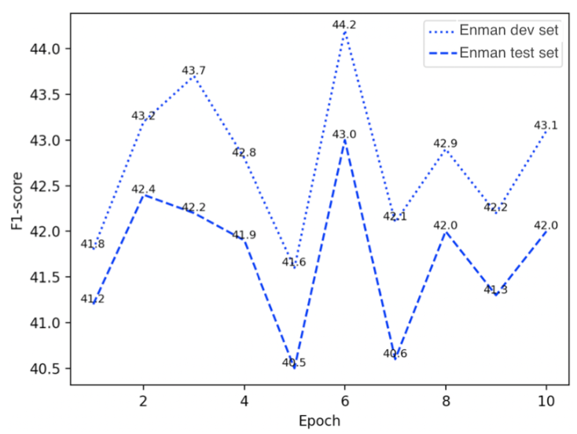
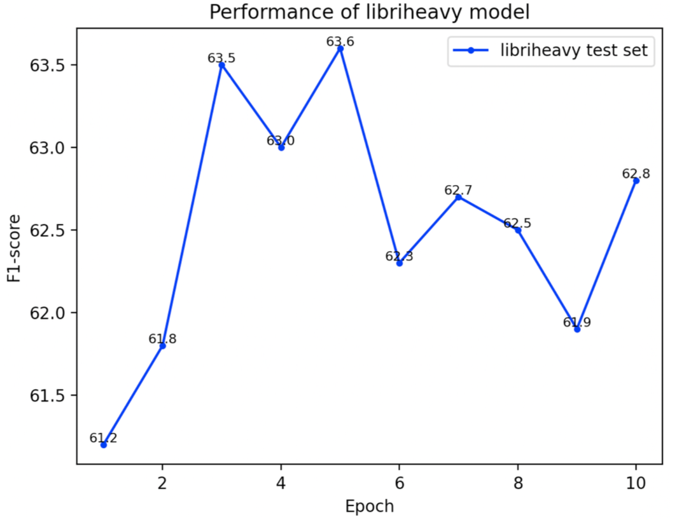
3.5 Experiment 1 – Baseline Models
Introduction
Methodology
Experiment
Conclusion
XLM - RoBERTa
Model Checkpoint Ensemble:
Dataset | NTU-Eng | NTU-Enman | Libriheavy
F1 Score | 69.7 | 44.8 | 64.4

Slide 27
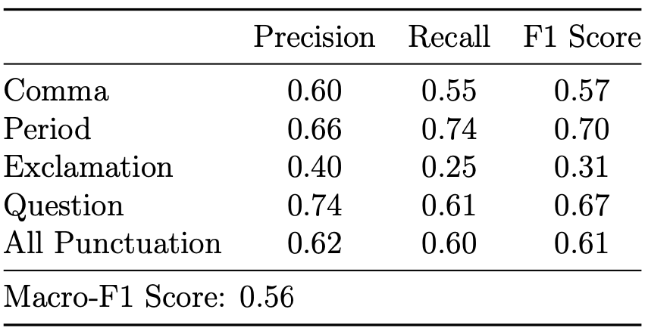
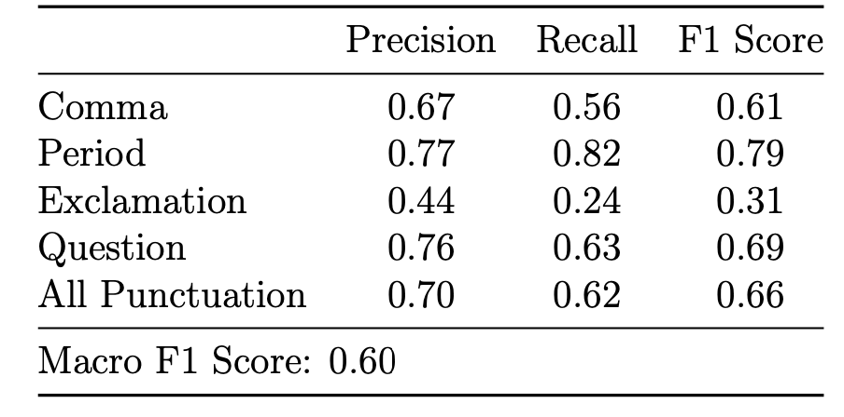
3.5 Experiment 1 – Baseline Models
Introduction
Methodology
Experiment
Conclusion
Base Llama-2 13B
Base Llama-2 w/o output postprocessing
Base Llama-2 with output postprocessing

Slide 28
3.6 Experiment 2 – Prompt Engineering
Introduction
Methodology
Experiment
Conclusion
3 Prompts for Llama-2
Prompt 1: Restore punctuations for the sentences:
Prompt 2: Restore punctuations for the sentences without changing any words:
Prompt 3: As a master of English grammar and punctuation, your task is to meticulously insert missing punctuation marks into the following text without changing any words or adding new content. Ensure the text’s original meaning and integrity are preserved, focusing solely on restoring punctuation where needed.
<Example 1> <Example 2>
Using the examples above, proceed to restore capitalization and insert the necessary punctuation marks into the text below:

Slide 29
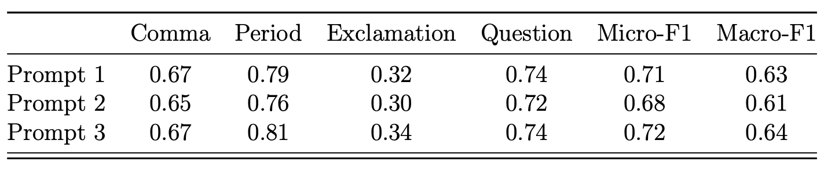
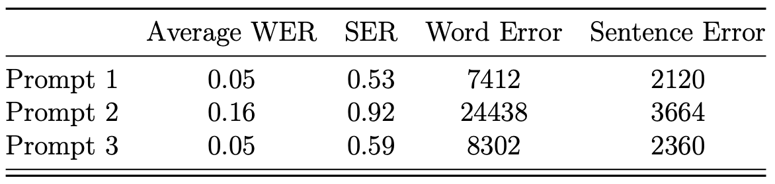
3.6 Experiment 2 – Prompt Engineering
Introduction
Methodology
Experiment
Conclusion
Results Comparison
F1 Scores of fintuned Llama-2 models with 3 different prompts
Error rates of finetuned Llama-2 models with 3 different prompts

Slide 30
3.7 Experiment 3 – Finetuned Llama2
Introduction
Methodology
Experiment
Conclusion
Setting for Comparison
Models: Base Llama-2; Finetuned Llama-2; Gemini
Prompt: prompt 3
Output post processing with extraction & reinsert
Problems with Gemini:
Occasionally encounters API errors
Additional undesired sentences

Slide 31
Introduction
Methodology
Experiment
Conclusion
3.7 Experiment 3 – Finetuned Llama2
Result Comparison (1)
 | Word | Comma | Period | Exclam | Question
Sampled Libriheavy | 29.9 K | 2.3 K | 1.2 K | 385 | 140
 | Comma | Period | Exclam | Question | Micro-F1 | Macro-F1
Llama_base | 0.58 | 0.72 | 0.20 | 0.67 | 0.60 | 0.54
Gemini | 0.63 | 0.74 | 0.31 | 0.76 | 0.65 | 0.61
Llama_finetune | 0.67 | 0.75 | 0.36 | 0.72 | 0.67 | 0.63

Slide 32
Introduction
Methodology
Experiment
Conclusion
3.7 Experiment 3 – Finetuned Llama2
Result Comparison (2)
 | Word | Comma | Period | Exclam | Question
Online Book | 16.9 K | 1.5 K | 0.7 K | 236 | 87
 | Comma | Period | Exclaim | Question | Micro-F1 | Macro-F1
llama_base | 0.70 | 0.76 | 0.43 | 0.77 | 0.70 | 0.67
gemini | 0.69 | 0.79 | 0.61 | 0.84 | 0.72 | 0.73
llama_finetune | 0.67 | 0.78 | 0.61 | 0.84 | 0.71 | 0.73

Slide 33
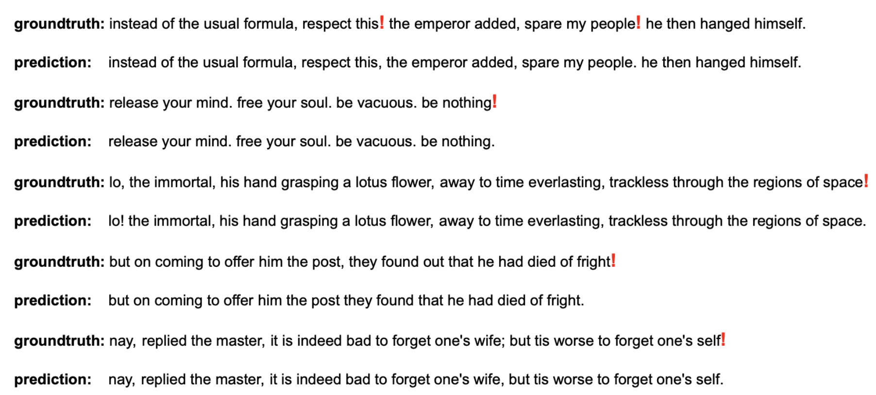
3.7 Experiment 3 – Finetuned Llama2
Introduction
Methodology
Experiment
Conclusion
Reasons for Low Exclamation Performance (1)
Inherent ambiguity of exclamation mark usage.
Variable thresholds for employing exclamation marks.

Slide 34
3.7 Experiment 3 – Finetuned Llama2
Introduction
Methodology
Experiment
Conclusion
Reasons for Low Exclamation Performance (2)
Contextual dependence of exclamation marks.
Inconsistent use of exclamation marks to convey emphasis or emotional intensity.

Slide 35
Introduction
Methodology
Experiment
Conclusion
Outline
Introduction
Methodology
Experiment
Conclusions & Future Work
Conclusions
Future Work
Contribution

Slide 36
4.1 Conclusions & Future Work
Introduction
Methodology
Experiment
Conclusion
Conclusions
Model checkpoint ensemble for XLM-RoBERTa improves 1-3% in F1-Score.
LLM output postprocessing step is necessary.
Prompt engineering cannot mitigate generative nature of LLMs.
Fine-tuning Llama-2 with LoRA shows a competitive result against SOTA Gemini with 0.73 F1 Score.

Slide 37
4.1 Conclusions & Future Work
Introduction
Methodology
Experiment
Conclusion
Future Work
Expanding the evaluation of LLMs to include additional datasets
Exploring alternative fine-tuning techniques and model architectures.
Contextual analysis for exclamation marks.

Slide 38
4.2 Contributions
Introduction
Methodology
Experiment
Conclusion
Achievements
Published Paper [1] accepted at 15th ACIIDS on Springer and won Best Student Paper Award.
Published Paper [2] accepted at 10th ICAICTA on IEEE.
Presented at Nanyang Speech Tech Forum
[1] Liu, Changsong, Thi Nga Ho, and Eng Siong Chng. "An Empirical Study on Punctuation Restoration for English, Mandarin, and Code-Switching Speech." Asian Conference on Intelligent Information and Database Systems. Singapore: Springer Nature Singapore, 2023.
[2] Changsong, Liu, et al. "Transformer-Based Punctuation Restoration Models for Indonesian with English Codeswitching Speech Transcripts." 2023 10th International Conference on Advanced Informatics: Concept, Theory and Application (ICAICTA). IEEE, 2023.

Slide 39

Thank you!
Introduction
Methodology
Experiment
Conclusion

